Slide 1
Digital Portfolio
Vinitha K
STUDENT NAME:
REGISTER NO AND NMID:
DEPARTMENT:
COLLEGE: COLLEGE/ UNIVERSITY
2428B0254 and D11B6A5ABEA5FF2922645A1AD26BEF75
Bsc Computer science with data analytics
Tiruppur kumaran College for women/
Baharathiar University

Slide 2
PROJECT TITLE
My Data analyst Digital portfolio

Slide 3


AGENDA
Problem Statement
Project Overview
End Users
Tools and Technologies
Portfolio design and Layout
Features and Functionality
Results and Screenshots
Conclusion
Github Link
3/21/2024 Annual Review

Slide 4

PROBLEM STATEMENT
Problem Statement
Recruiters and organizations often find it difficult to assess a data analyst’s practical skills through a traditional résumé alone. While resumes list tools and qualifications, they rarely demonstrate how those skills are applied to solve real-world problems. Similarly, aspiring analysts like me need a structured way to showcase projects, skills, and data-driven solutions in a professional and interactive format.

Slide 5

PROJECT OVERVIEW
This digital portfolio is designed as an interactive showcase of my work as a Data Analyst. It brings together my skills, projects, and achievements in one accessible platform, allowing recruiters and collaborators to explore my capabilities beyond a traditional résumé.
The portfolio highlights four key components:
1. Projects Section – A collection of real-world data analysis projects with descriptions, tags (Python, SQL, Power BI), and downloadable sample datasets.
2. Skills Dashboard – A visual bar-based summary of my proficiency in Python, SQL, Excel, and Power BI.
3. Resume & Contact Integration – Options to download my résumé and connect with me directly through the contact form.
4. Interactive Features – Project search, filters, and modal pop-ups for detailed insights into each project.

Slide 6

WHO ARE THE END USERS?
The primary end users of this digital portfolio are:
1. Recruiters and Hiring Managers
To quickly evaluate my technical skills, past projects, and problem-solving abilities.
To access my résumé and contact details in one place.
2. Potential Employers / Clients
To explore real-world data analytics projects and dashboards before considering me for internships, jobs, or freelance roles.
To download sample datasets or view case studies that showcase my approach to data problems.
3. Peers and Academic Mentors
To review my learning progress, give feedback, and collaborate on future analytics projects.
4. Professional Network (LinkedIn connections, colleagues)
To understand my strengths and endorse my expertise in tools such as Python, SQL, Excel, and Power BI

Slide 7
TOOLS AND TECHNIQUES
🛠 HTML5 → For structuring the portfolio layout and sections.
🎨 CSS3 → For styling, dark theme design, and responsive interface.
⚡ JavaScript → For interactivity (search, filters, pop-ups, downloads).
📱 Responsive Design → Ensures usability across desktop, tablet, and mobile.
🗂 Card-Based Layout → Clean presentation of projects with images and tags.

Slide 8
POTFOLIO DESIGN AND LAYOUT
1. Header / Navigation
Logo / Initials (e.g., “VK”).
Name + Role (e.g., Vinitha – Data Analyst).
Quick buttons → Download Resume | Hire Me.
---
2. Hero Section (Introduction)
Profile picture or avatar.
Short intro text → “Turning raw data into business insights.”
Quick stats → Number of Projects, Certifications, Experience.
—
‹#›

Slide 9
FEATURES AND FUNCTIONALITY
1. User-Friendly Design
Responsive layout (works on desktop, tablet, and mobile).
Dark theme with modern UI for professional look.
Card-based project display for easy navigation.
2. Project Showcase
Grid layout with project cards (title, description, image, tags).
Search and Filter – Recruiters can quickly find projects by keyword or tool (Python, SQL, Power BI).
View More (Modal) – Opens detailed project description with images and techniques.
Download Sample Data – Allows recruiters to download demo datasets (CSV).
3. Skills Representation
Visual progress bars to show proficiency in Python, SQL, Excel, and Power BI.
Clear categorization of technical tools and data analytics techniques.

Slide 10
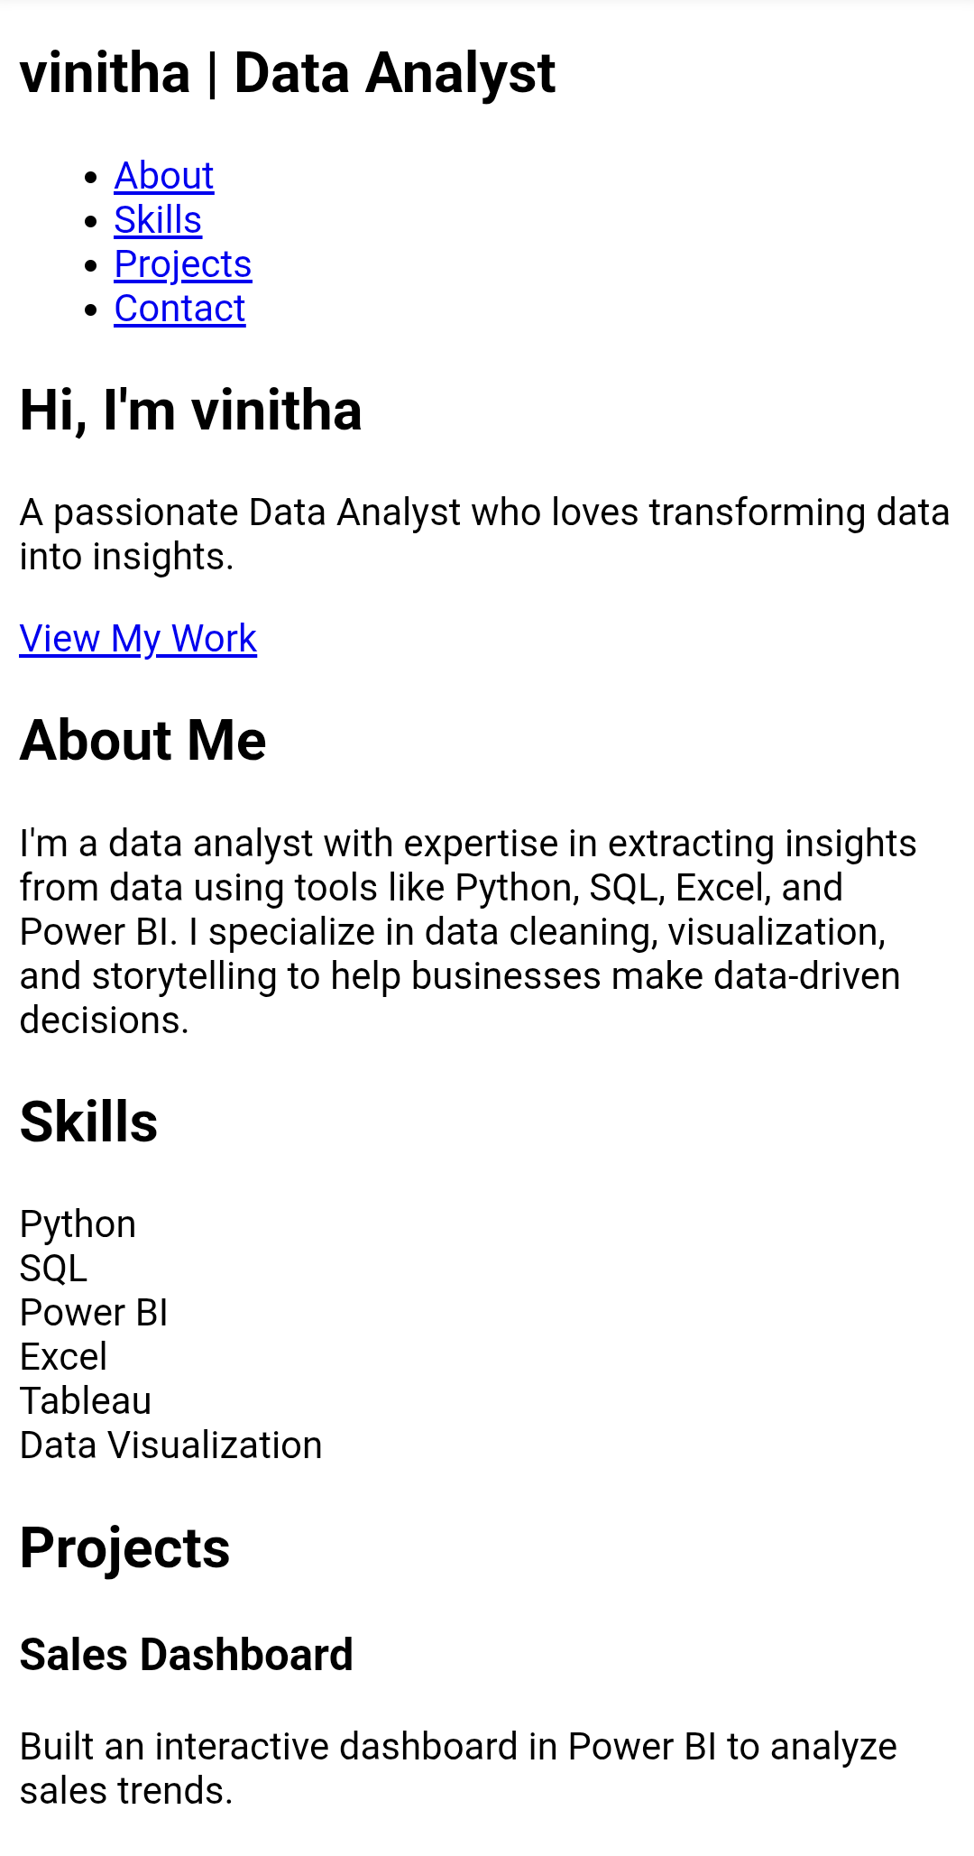
RESULTS AND SCREENSHOTS
3/21/2024 Annual Review
‹#›

Slide 11
CONCLUSION
This portfolio serves as an interactive professional platform that goes beyond a traditional résumé by showcasing my technical expertise, problem-solving ability, and real-world data analytics projects. It highlights my proficiency in Python, SQL, Excel, and Power BI, while also demonstrating my ability to present insights in a clear and engaging way.
By integrating features such as project filtering, skill dashboards, résumé download, and a contact form, the portfolio not only reflects my technical skills but also my attention to design, accessibility, and user experience.
Overall, this portfolio establishes me as a skilled and job-ready Data Analyst, providing recruiters, employers, and collaborators with a transparent view of my capabilities and achievements.
‹#›

